Slide 1
What is German about German Music? (1 of 4)
Erik Levi
Royal Holloway, University of London
Content © Erik Levi, April 2018 – All rights reserved

Slide 2
Introductory points
Words ‘German’ and ‘Music’ are so inextricably linked that their connection is hardly ever challenged.
The primacy of the three B’s – Bach, Beethoven and Brahms – reinforces the notion of Austro-German leadership in musical developments that have prevailed over the past few centuries and dominated our concert and, to a lesser extent, our operatic repertoires.
Even today, Germany and Austria are regarded as the twin country centres of Western classical music – leading orchestras, opera houses, conservatoires, conductors, educators, music scholars.
When critics discuss works by composers from countries such as Finland, Norway, Spain and Russia as products of musical nationalism, they are implicitly measured against universally accepted notions of German music.
Conversely, composers emanating from these countries are assessed on the basis as to what extent they deviate from Germanic norms.

Slide 3
How did music come to be so closely identified with Germany and Germanness? How was it that music was considered “the most German art”? (Thomas Mann)
Ironically, perceptions of Germanness in music not so much the province of the composers writing the actual music (at least initially), but rather more related to those writing about the music, whether in literature, philosophy, diaries, journalism and academic scholarship
It was these figures that shaped the way that German music was perceived, ultimately affecting composition, performance and above all the placing of German music in a position of central importance for the nation
So it becomes clear that the link between music and German identity can more often than not be connected to writers, thinkers, politicians, educators, commercial interests and to a certain extent audiences, but only occasionally to the composers.

Slide 4
Political harnessing of music with German identity
Began tentatively in the late eighteenth century but gradually rulers in the various separate states realised the value of music as a national inheritance and a treasure to be promoted, e.g. Frederick Wilhelm IV of Prussia and support and patronage of Mendelssohn in the 1840s, and in a more extreme way, Ludwig 1 of Bavaria with Valhalla Dome in Regensburg featuring marble busts of composers alongside those of rulers
Most overt when Germany was ruled by dictatorships (both fascist and communist)
Music harnessed to bolster national morale e.g. 1941 Mozart anniversary celebrations exploited to serve war effort. Quote from Propaganda Minister Joseph Goebbels: “Mozart’s music rings out every evening over homeland and front. It is part of what our soldiers are defending against the wild assault of eastern barbarism. It is ours more strongly than any other artistic work… it has become the property of the broadest masses of the German people”
Musical iconography harnessed to political ends – potent examples dating from the Nazi era

Slide 5
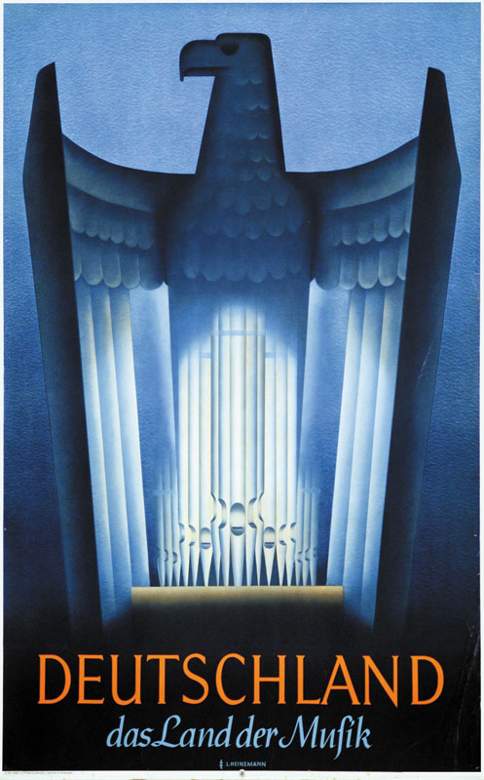
Nazi Poster from 1937

Slide 6

The antithesis of German Music

Slide 7
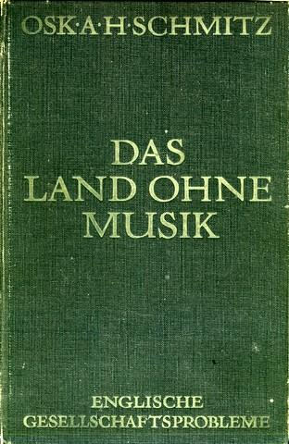
Anti-British First World War Book

Slide 8
Oskar Schmitz: Das Land ohne Musik
“Finally, I have found something which distinguishes English people from German culture to quite an astonishing degree, a lack which everybody acknowledges but has not been emphasised enough. The English are the only civilised nation without its own music (except street music). This does not mean that they have less sensitive ears, but that their whole lives are much poorer for it. To have music in oneself, even if ever so little, means being able to forget oneself and to tolerate dissonance, even linger with it, because it is resolved in harmony. Music gives us wings and makes everything miraculous easy to understand.”

Slide 9
Marketing perceptions of German musical identity
Again iconography poses very useful imagery for the symbiotic relationship between music and German identity: consider these advertisements for travel to Germany that appeared in British periodicals during the twentieth century.

Slide 10
Pre World War Two Travel adverts,
emphasising German primacy in Music:

Slide 11
Post World War Two advert, still emphasising
Germany as the Land of Music:

Slide 12
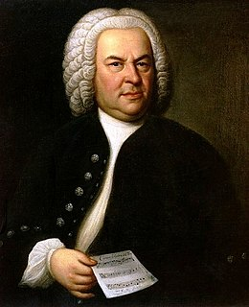
German National identity in Bach, Beethoven and Brahms
Johann Sebastian Bach (1685-1750)
Only local reputation during his lifetime (unlike his cosmopolitan contemporary Handel)
Neglected after his death
Revival begins in 19th century with Forkel biography

Slide 13
Ueber Johann Sebastian Bach
Leben, Kunst und Kunstwerke
Johann Nikolaus Forkel (publ. 1802)
Bach’s works are a priceless national patrimony; no other nation possesses a treasure comparable to it. All who hold Germany dear are bound in honour to promote his music to the utmost of their power. I deem it a duty to remind the public of this obligation and to kindle interest in it in every true German heart. (Introduction)
He touches Luther, is in a sense his complement, his art built on the foundations Luther laid, consecrated to the ends Luther vindicated, inspired by a dedication of himself to God’s service not less exalted—a great artist, a great Protestant, a great man. (Cantata Chapter)
This man, the greatest orator-poet that ever addressed the world in the language of music, was a German! Let Germany be proud of him! Yes, proud of him, but worthy of him too! (Closing paragraph of Forkel’s book)

Slide 14
Bach revival in 19th century
1829 Mendelssohn’s revival of St Matthew Passion set an important trend, becoming more than a quest to perform unfamiliar music. In fact it became a national movement of cultural unity historicising past great German music as a great heritage to be respected
Attendance at and amateur participation in choral performances of Bach’s music through the nineteenth century helped to created a shared sense of German identity and community
The creation of the Bach Gesellschaft in 1850 dedicated to publishing all of Bach’s music and making it accessible to everyone
1869 first performance of Richard Wagner’s opera Die Meistersinger (around the time of the unification of Germany) a parable about German art (i.e., song) and its renewal imbued with the spirit of Bach through:
  artful use of Bach–like counterpoint (several musical lines working together simultaneously), a symbol of reconciliation between technical craftsmanship and poetic inspiration; and
  strong references to the Lutheran chorale (a historicising spirit)

Slide 15
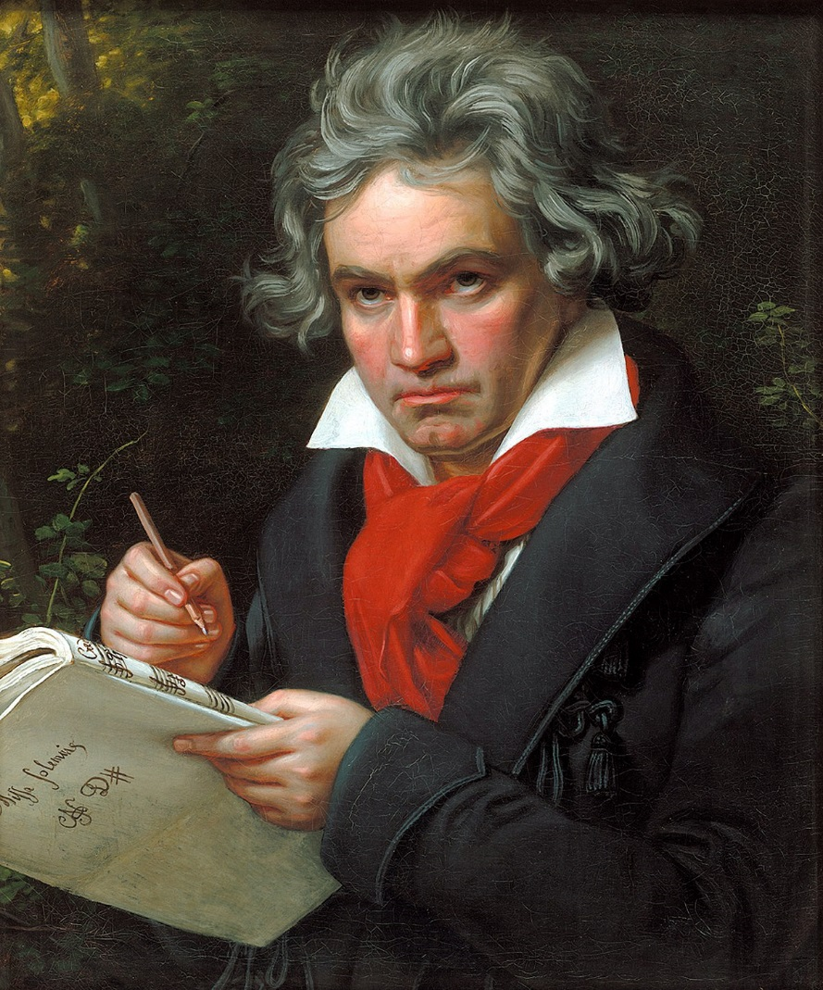
Ludwig van Beethoven (1770-1827)
First German composer to take an active interest in politics
Yet despite existence of some patriotic music “laying his work upon the altar of the Fatherland”, little evidence to suggest he was a German nationalist in the sense we understand it
It was a later generation who valued his titanic achievements which left an indelible impact on all subsequent German music
Musicians as different in outlook as Brahms and Wagner were in awe of him, but for different reasons
Politicians through the ages exploited Beethoven’s music for its heroic spirit, physical power and universality

Slide 16
Beethoven
This concept of German identity established in the wake of Beethoven’s death in 1827
Consider this quotation from composer Robert Schumann, writing in 1839:
  “When the German speaks of symphonies, he means Beethoven; the two names are for him one and indivisible - his joy, his pride. As Italy has its Naples, France its Revolution, England its Navy, etc., so the Germans have their Beethoven symphonies. The German forgets in his Beethoven that he has no school of painting; with Beethoven he imagines that he has reversed the fortunes of the battles that he lost to Napoleon; he even dares to place him on the same level with Shakespeare.”

Slide 17
Beethoven
Wagner, 1870:
  “For inasmuch as Music had been degraded to a merely pleasing art, Beethoven raised her to the height of her sublime vocation. He has set open for us the understanding of that art which explains the world to everyone as surely as the profoundest philosophy could ever explain it to the abstract thinker. And herein lies the unique relation of the great Beethoven to the German People.”

Slide 18
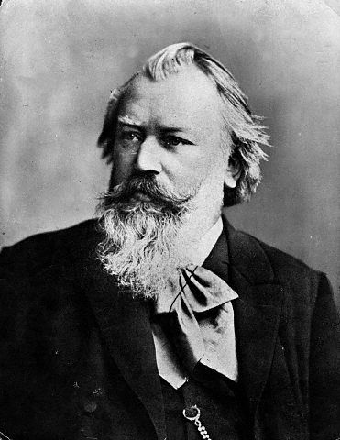
Johannes Brahms (1833-1897)
Like Mendelssohn, looked back to the past musical styles of the German baroque and the 18th century classical tradition as the basis of his musical style
However, also lived during the age of German unification and celebrated this event in an overtly patriotic if not zealously nationalist manner (e.g.: Triumphlied)

Slide 19
Brahms: Triumphlied
Patriotic composition written in celebration of
German Victory in the Franco-Prussian War 1871

Slide 20
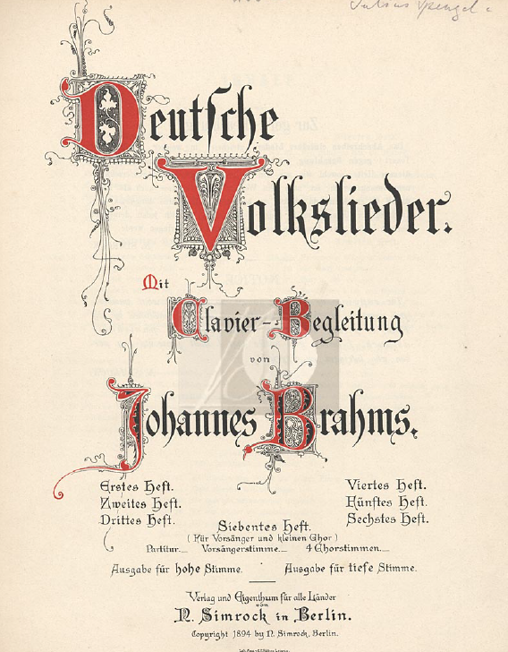
Romantic nationalism in Brahms
The new most notable Germanic element in Brahms’s outlook that places him in a somewhat different category to Bach and Beethoven is his devotion to folk music
It is folk music or rather lyrical song, combined with his devotion to the past and his Lutheran protestant upbringing, that marks him out as an intrinsically German composer

Slide 21
Brahms and the German spirit:
Speech by conductor Wilhelm Furtwängler (1933)
Brahms belongs to that race of Germanic musical giants which began with Bach and Handel. He combined immense physical strength with the utmost sensitivity and gentleness.
Both in build and character he was typically Nordic – I like to see him as a descendant of those old painters like Rembrandt and Van Eyck whose works combine warmth and intensity of imagination with a fearful concentration of power and a wonderful sense of form.
The people, the folksong world to which Brahms belonged, was German …. He had no choice, and although he eagerly responded to stimuli from all over the non-German world, it was in terms of his Germanness that he came to understand and conquer this world.

Slide 22
Do the Germans have a specific national character in their music, and if so can we define them more specifically?
Any definition needs to be sufficiently flexible to accommodate possible disparities in German music, yet cohesive enough to serve as some kind of unified concept. With this in mind, we can highlight certain underlying trends, both exclusivist and universal, which happily coexist in the greatest music:
German music is distinguished from non-German music through its depth, hard work and thoroughness (Tiefsinn, Arbeit, Gründlichkeit), qualities that are less pervasive in the music of other countries.
German music generally favours intellect over sensuality, harmony over melody, metaphysical over physical, organic over mechanical, development over sequence, ideas over entertainment.
German music is both universal and synthetic, it fuses elements of other musical cultures (e.g., French and Italian) into something homogenous. Form and expression are unified, as are the horizontal and vertical in musical writing.

