Slide 1
What is German about German Music? (2 of 4)
Erik Levi
Royal Holloway, University of London
Content © Erik Levi, April 2018 – All rights reserved

Slide 2
Music example 1
Bach Fugue
A contrapuntal composition in which a short melody of phrase is introduced in one part and successively taken up by others (in this case three separate parts) and developed through interweaving the parts.

Slide 3

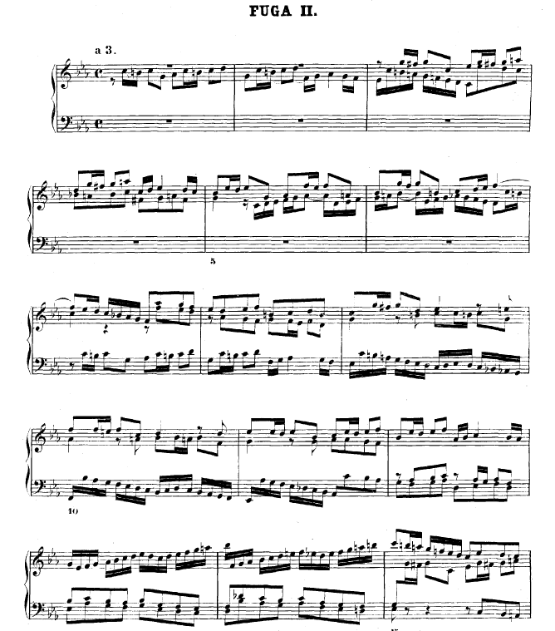
Main fugue theme
Fragment of Fugue theme

